Slide 1

Principal Component Analysis (PCA) of metabolomic sample processing methods
Goal:
Use PCA to identify the major modes of variance
Topics:
Principal component number selection
Data pretreatment
PCA results visualization
Principal Components Analysis

Slide 2
Principal Components Analysis
Used DATA: Pumpkin data 1.csv
Steps
Calculate a PCA model
Select optimal model principal component (PC)
Overview PCA scores and loadings plots
Repeat steps 1-2 using data centering and scaling
Visualize:
Sample scores annotated by extraction and treatment
Leverage and DmodX (distance from model plane)
Variable loadings and biplots
Exercise:
How many PCs are needed to capture 80% variance for raw data and scaled data?
Are their any moderate or extreme outliers?
What variables contribute most to the variance for raw and scaled data?
Principal Components Analysis

Slide 3
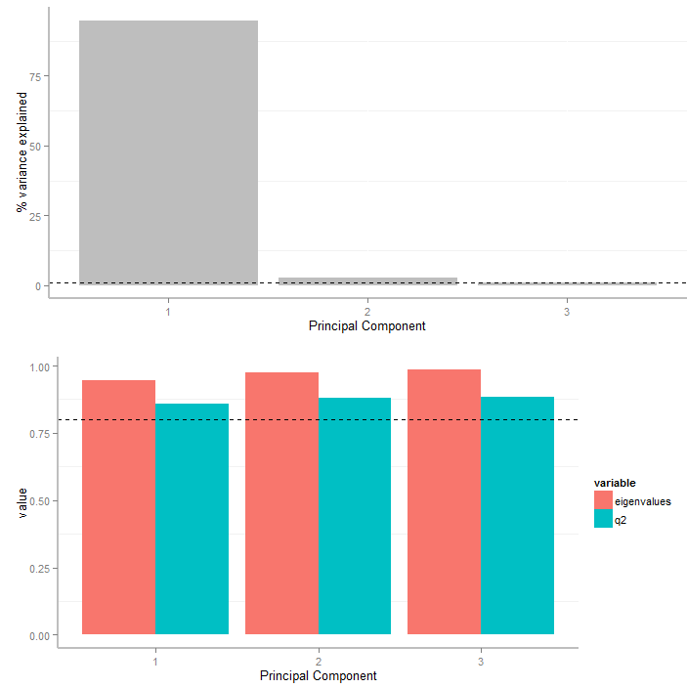
PCA Variance Explained
(raw data)
PCs can be selected to explain a minimum %variance in the data (~80%)
PCs explaining below 1% variance can be excluded
Principal Components Analysis
q2 is the cross-validated PCA prediction of left out data

Slide 4
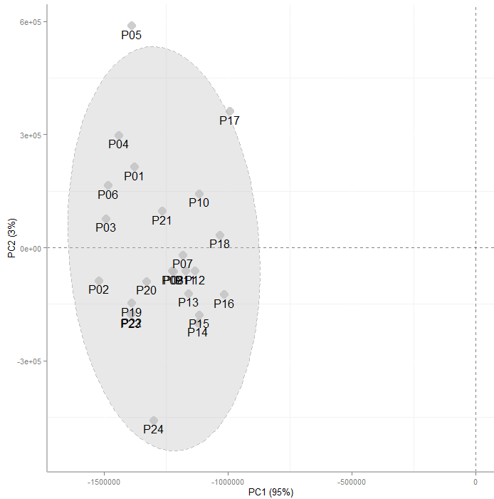
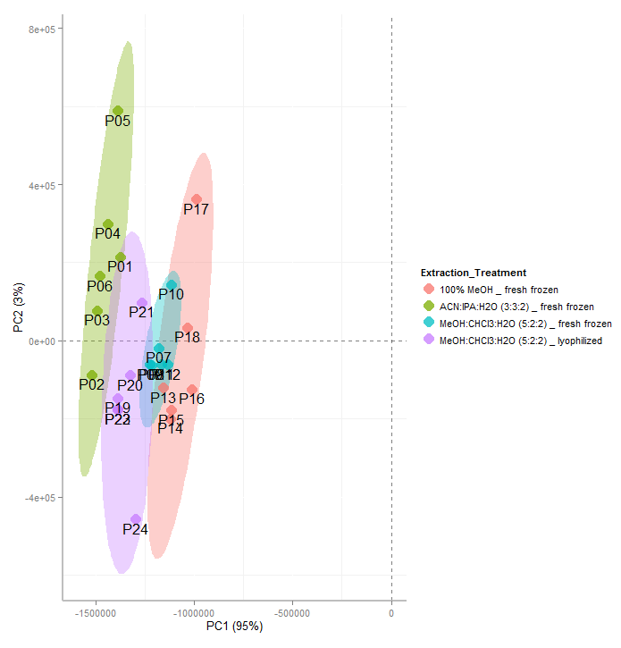
PCA Scores (raw data)
Principal Components Analysis
Hotelling's T² ellipse shows 95% CI for bivariate normal distribution
Samples lying outside of the ellipse could be outliers

Slide 5
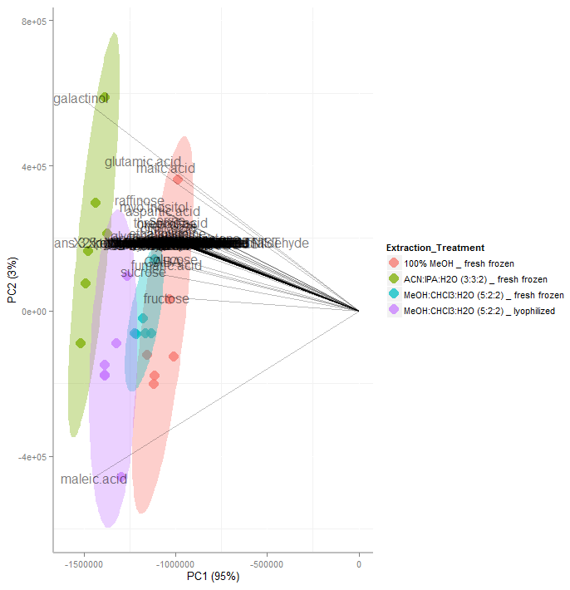
PCA Biplot (raw data)
Increase in analyte concentration
Principal Components Analysis
The first component (PC1) captures the general increase in all analytes
ACN:IPA:H20 >MeOH:CHCL3:H20 (lyophilized) > MeOH:CHCL3:H20 (fresh) > 100% methanol
With non-centered data it is hard to detect differences between extractions

Slide 6
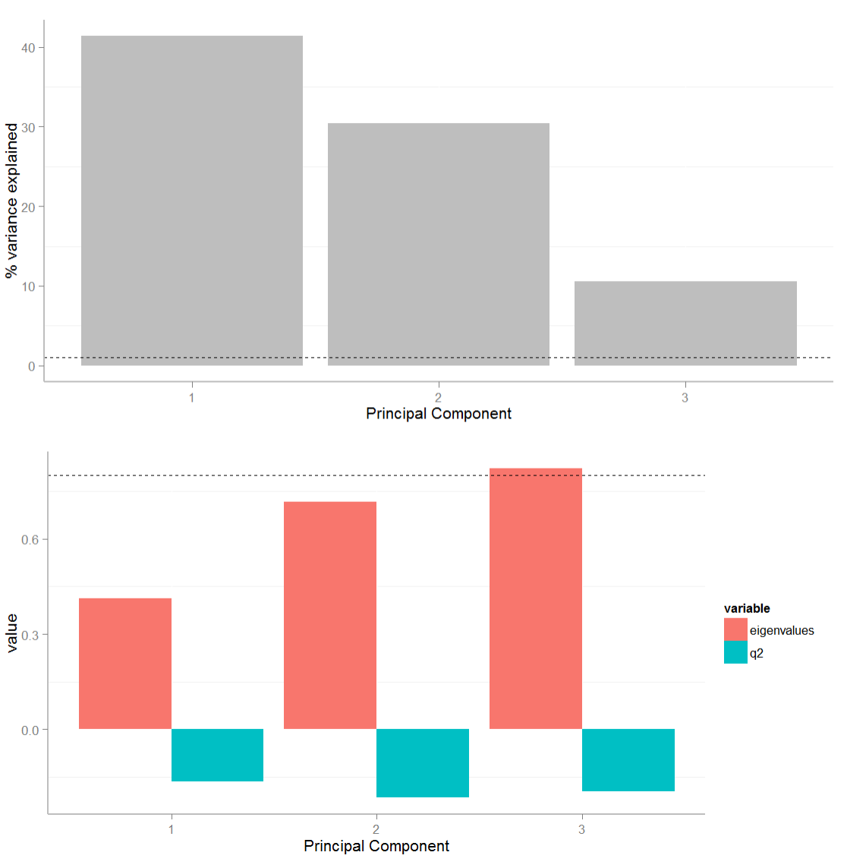
PCA Variance Explained
(mean centered)
Principal Components Analysis
q2 is low due to instability in the mean of each analyte

Slide 7
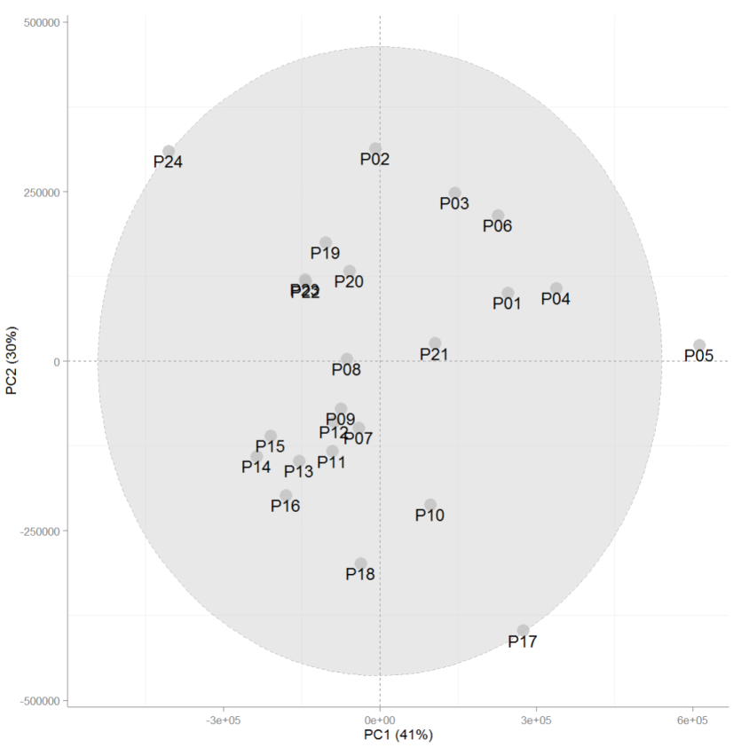
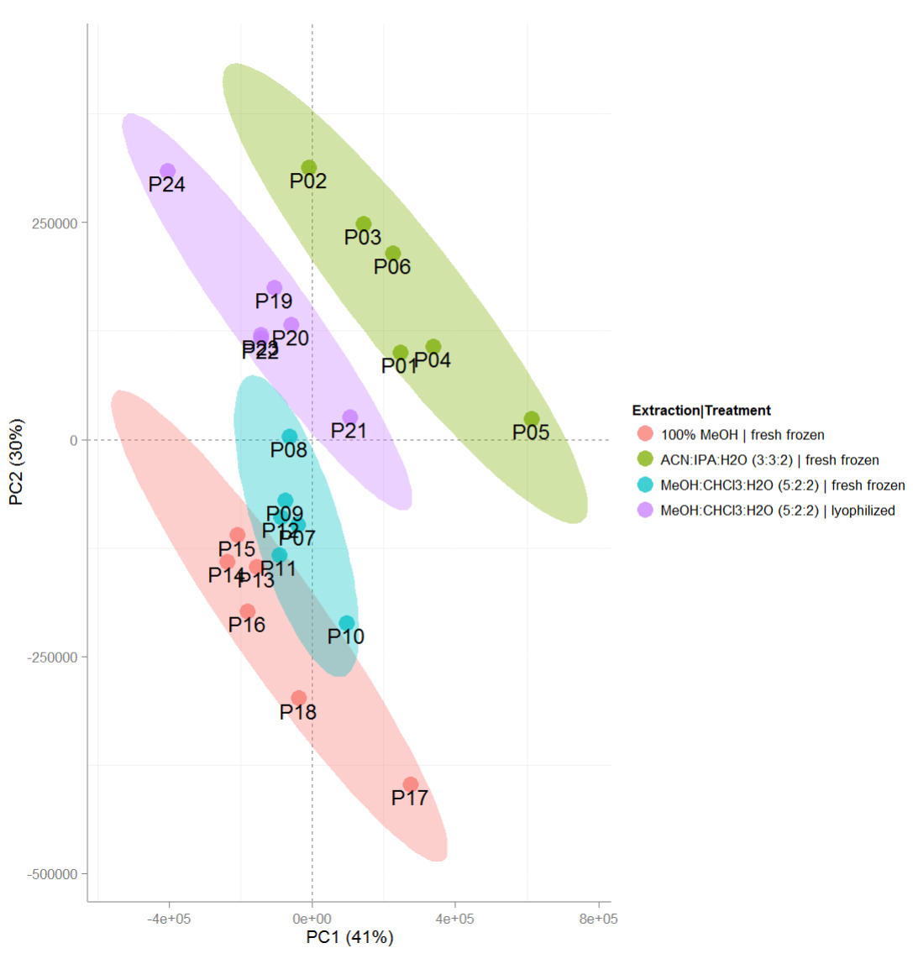
PCA Scores (raw data)
Principal Components Analysis

Slide 8
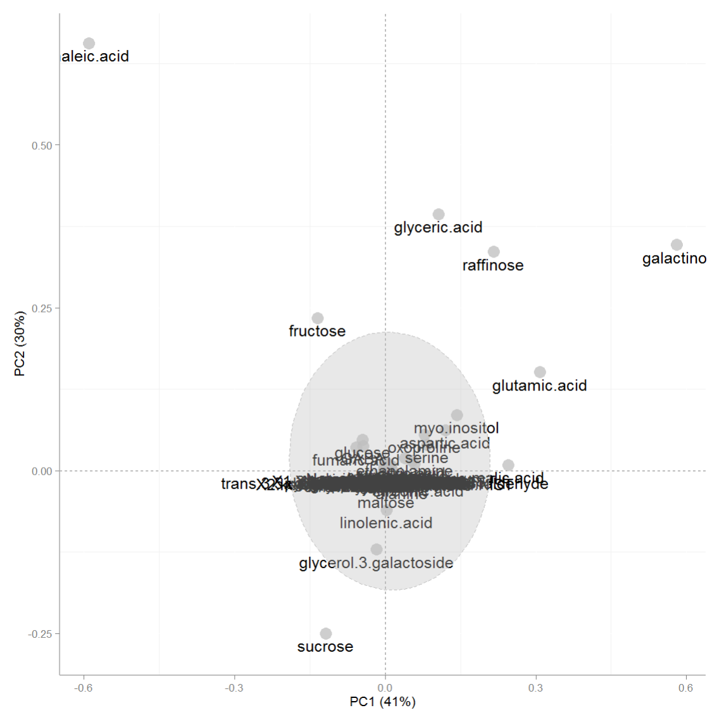
PCA Loadings
(mean centered)
Principal Components Analysis
Unscaled data PCA loadings are highly correlated with magnitude

Slide 9
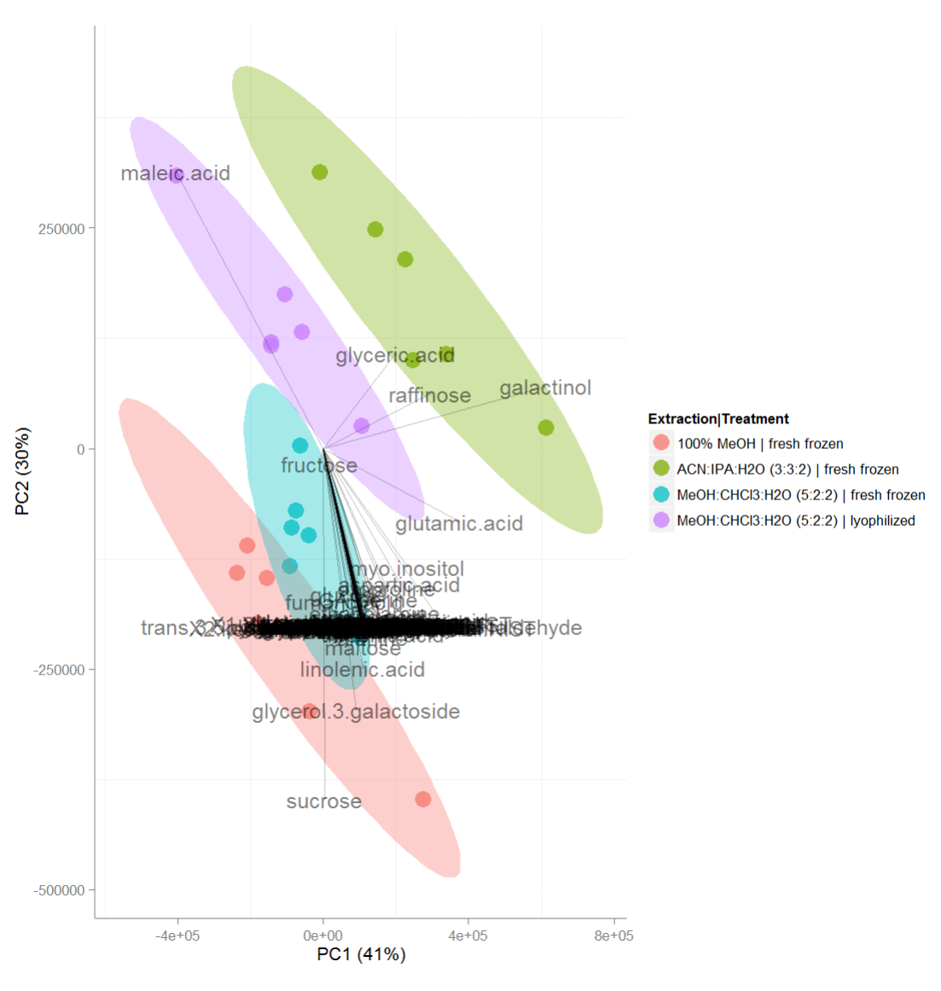
PCA Biplot (raw data)
Sample contains high maleic acid
Principal Components Analysis
Biplots can be used to rapidly overview the correlation between sample scores and variable loadings
Sample contains high sucrose (low maleic acid)

Slide 10
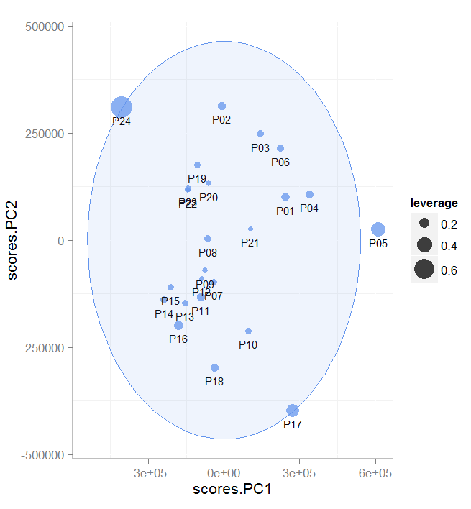
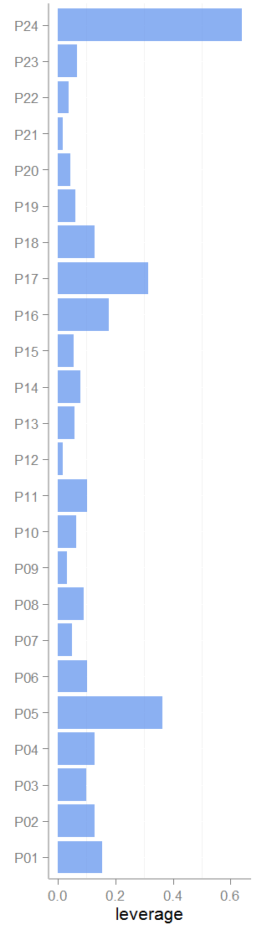
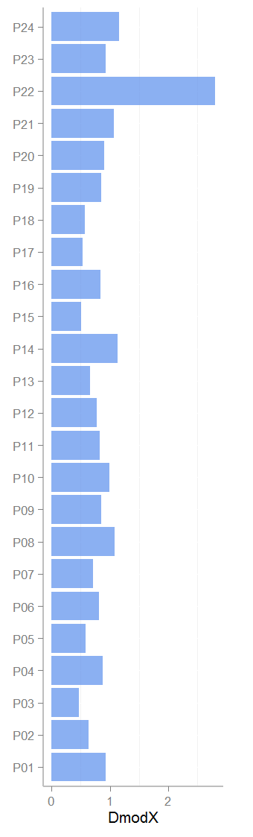
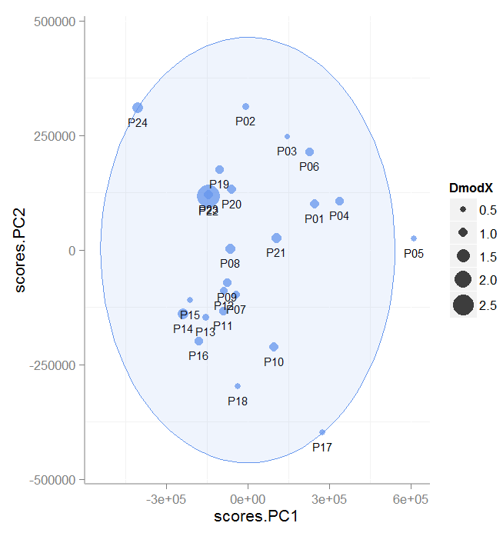
PCA Leverage and DmodX
(mean centered)
Leverage is the distance to samples center in the PCA plane (extreme outliers)
Distance to model X (DmodX) is the orthogonal distance to the PCA plane (moderate outliers)
Principal Components Analysis

Slide 11
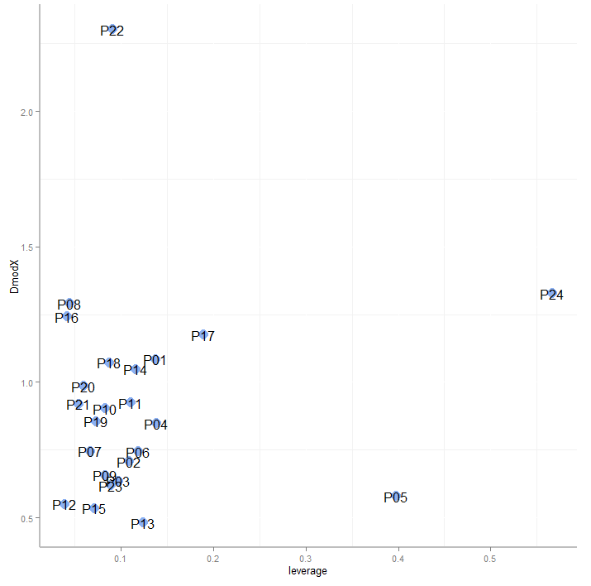
Detecting outliers
Sample with both high leverage and DmodX are likely outliers and can negatively effect statistical tests and predictive modeling
Principal Components Analysis

Slide 12
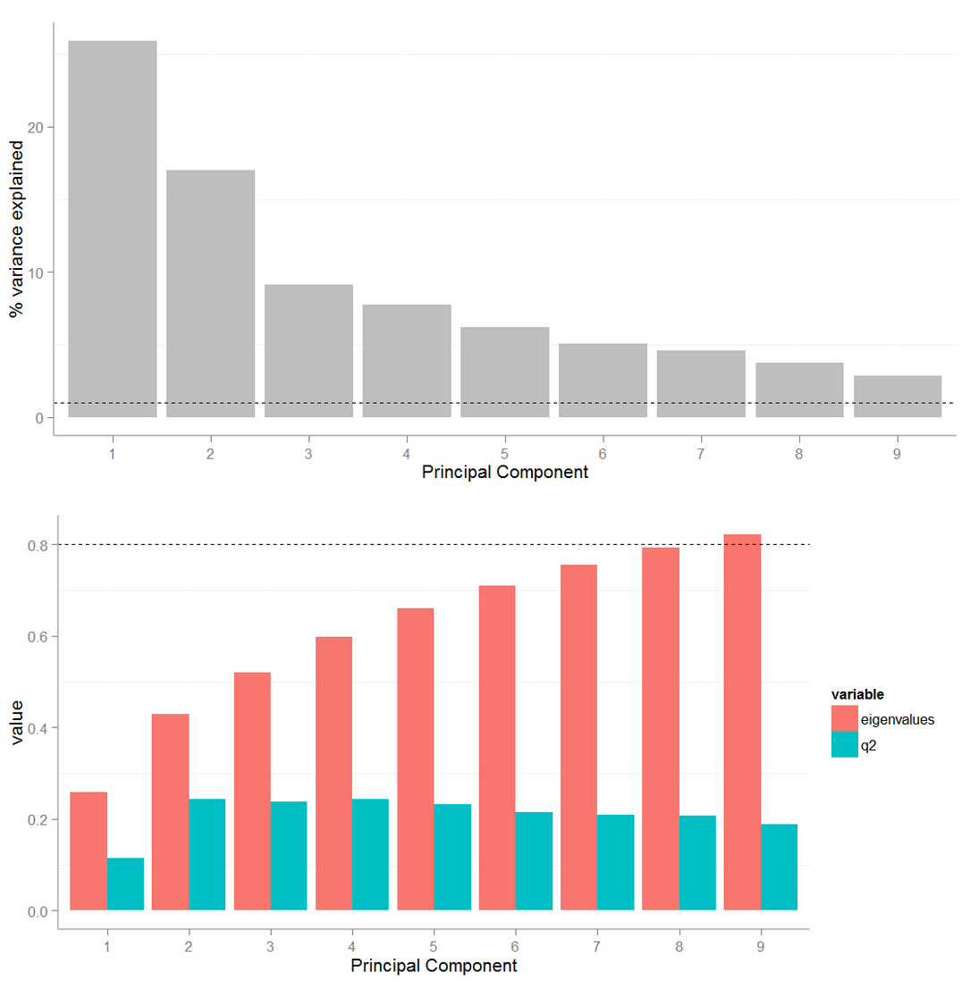
PCA Variance Explained
(autoscaled)
Principal Components Analysis

Slide 13
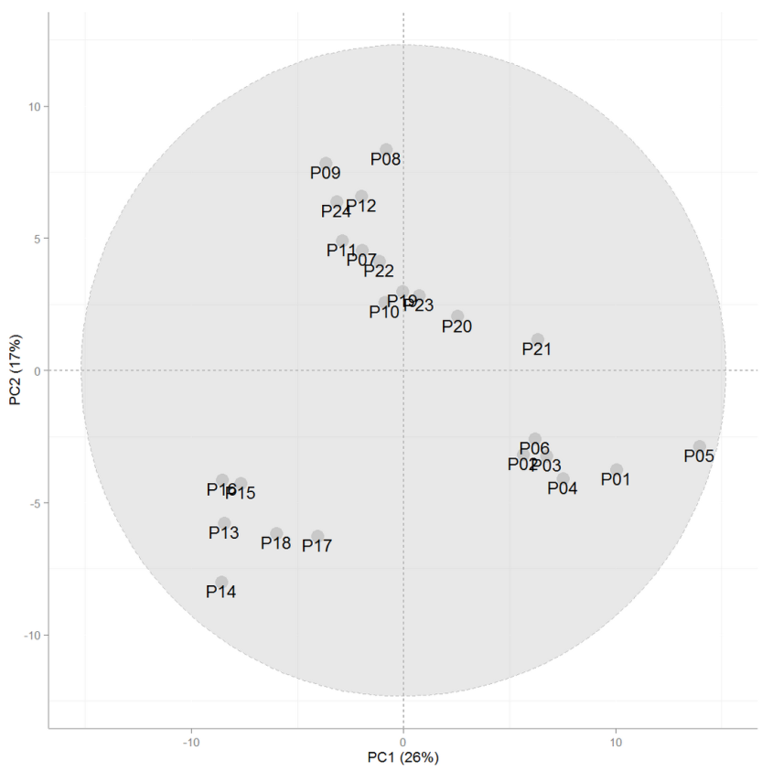
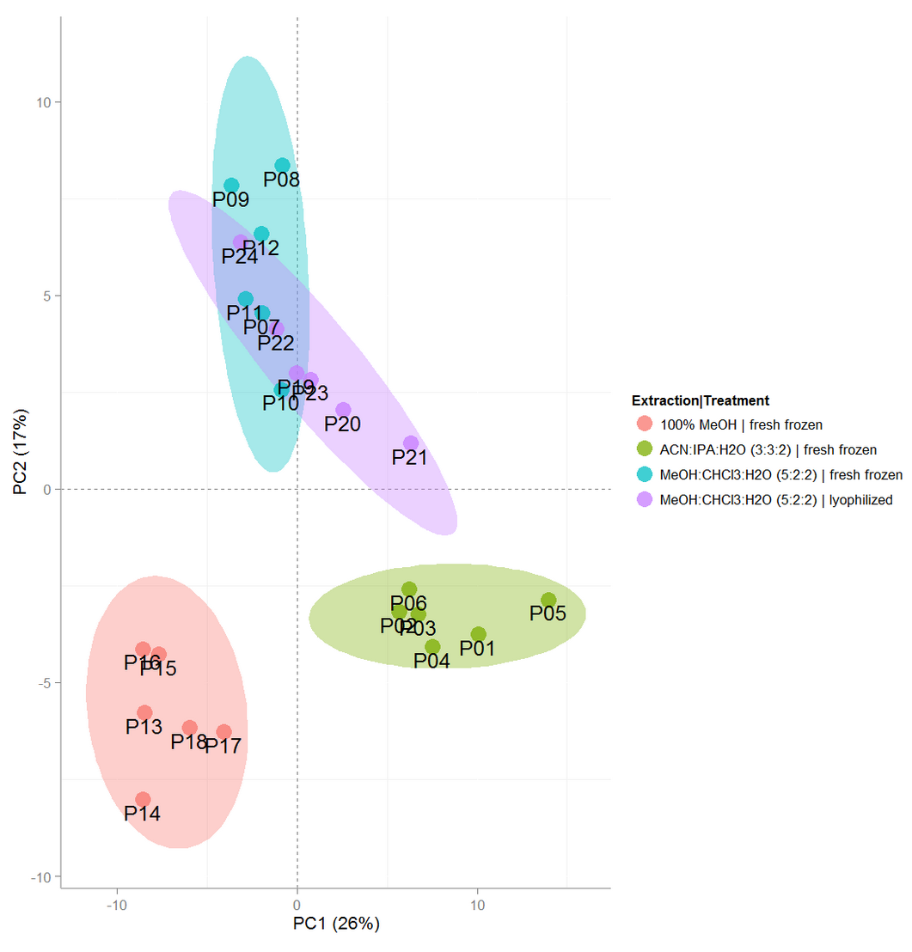
PCA Scores (autoscaled)
Principal Components Analysis
Loadings on PC1 describe differences due to extraction
Loadings on PC2 describe differences due to drying

Slide 14
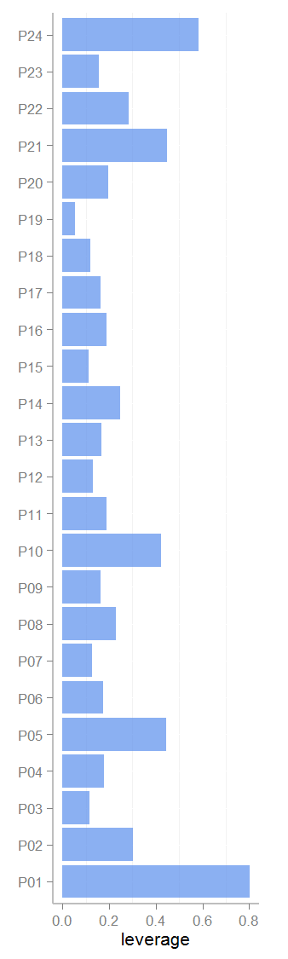
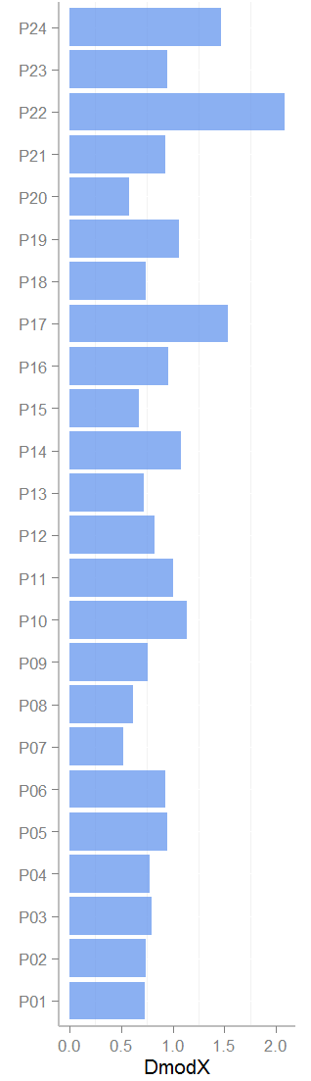
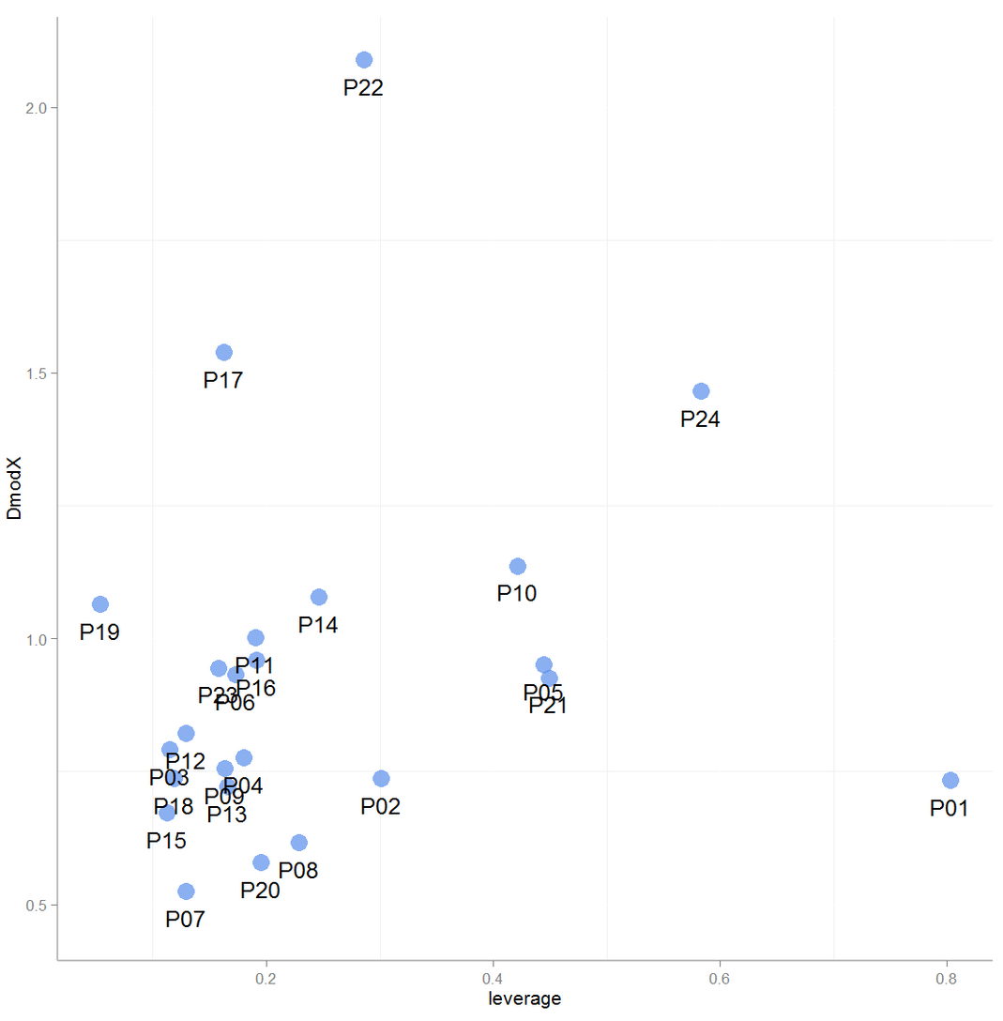
PCA Leverage and DmodX
(autoscaled)
Principal Components Analysis

Slide 15
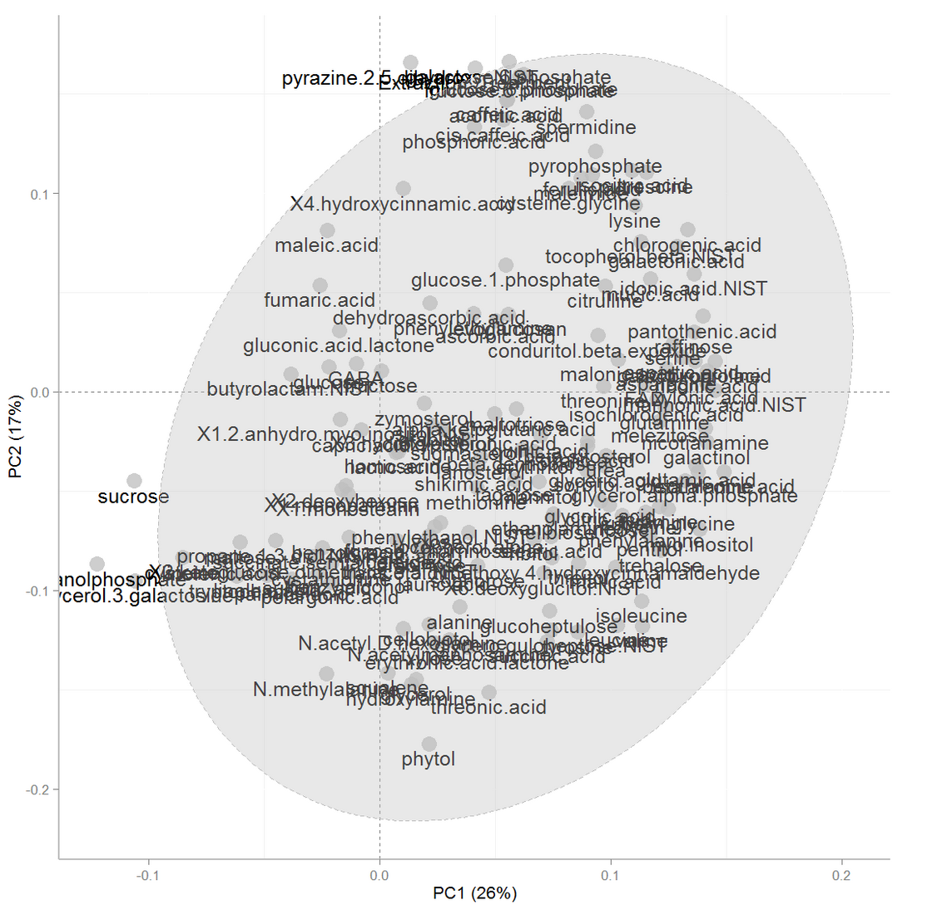
PCA Loadings (autoscaled)
Principal Components Analysis
Scaled loadings are independent of variable magnitude and show a rich variance structure of the data

Slide 16
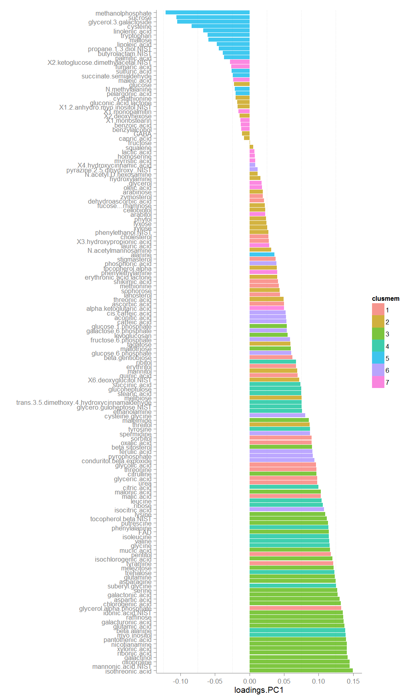

Relationship between scores and loadings (autoscaled)
Higher in 100% MeOH
Principal Components Analysis
Lower in 100% MeOH
Extraction

Slide 17

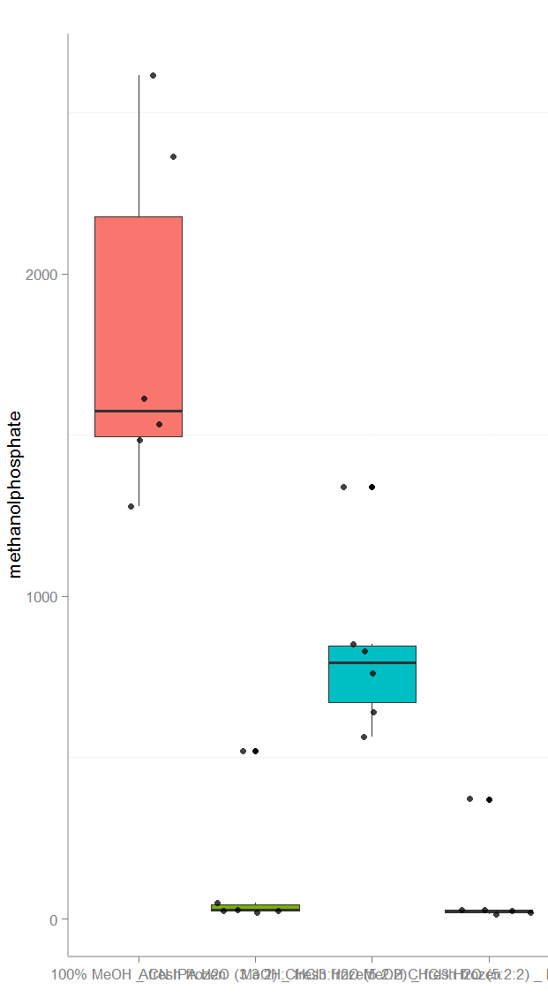
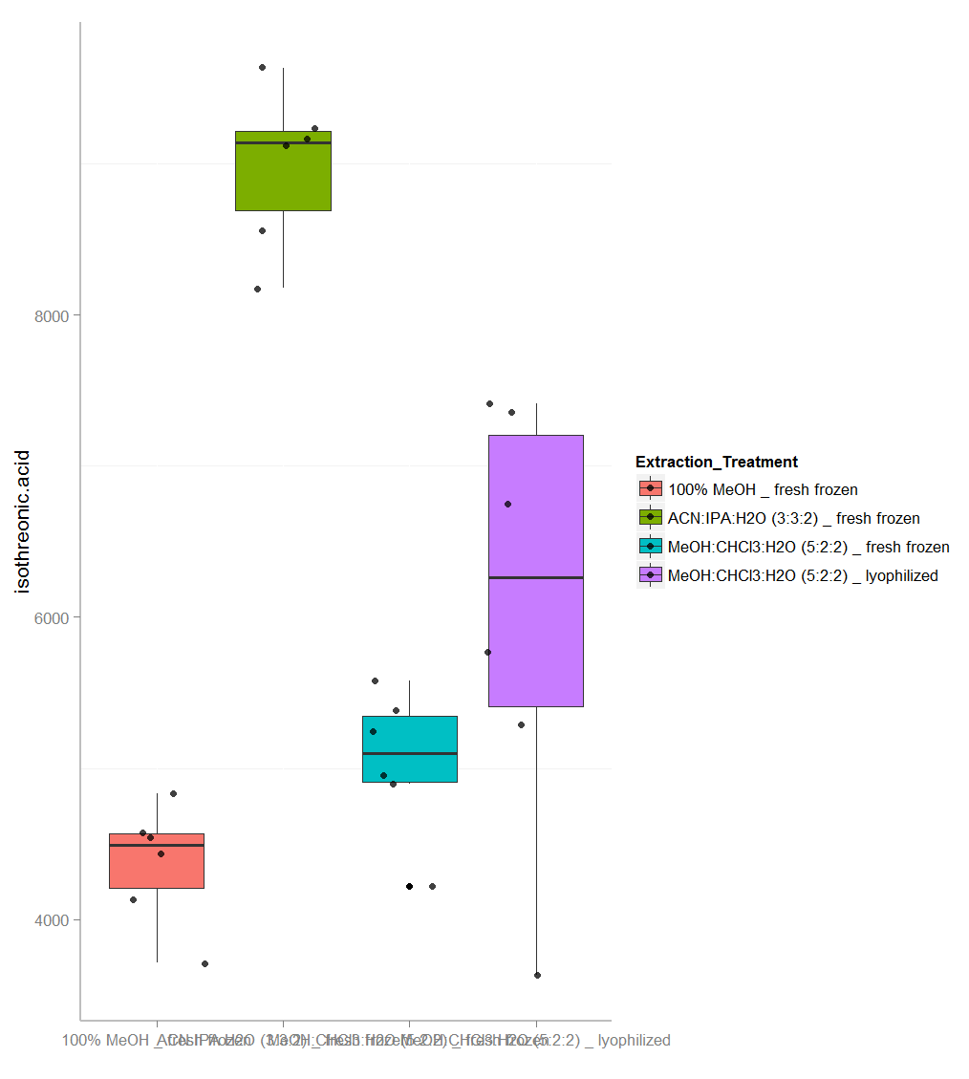
Loadings and Scores
Highest negative loading on PC1
Highest positive loading on PC1
Principal Components Analysis

